Slide 1
Kei te aha koutou?
What are you all Doing?

Slide 2
Kei te aha Ā Ms Heather?
Kei Te korikori tinana Ā Ms Heather.
( Ms Heather is exercising)

Slide 3
Kei te aha Ā Mrs Mayerhofler?
Kei te oma Ā Mrs Mayerhofler.
(Mrs Mayerhofler is running)

Slide 4
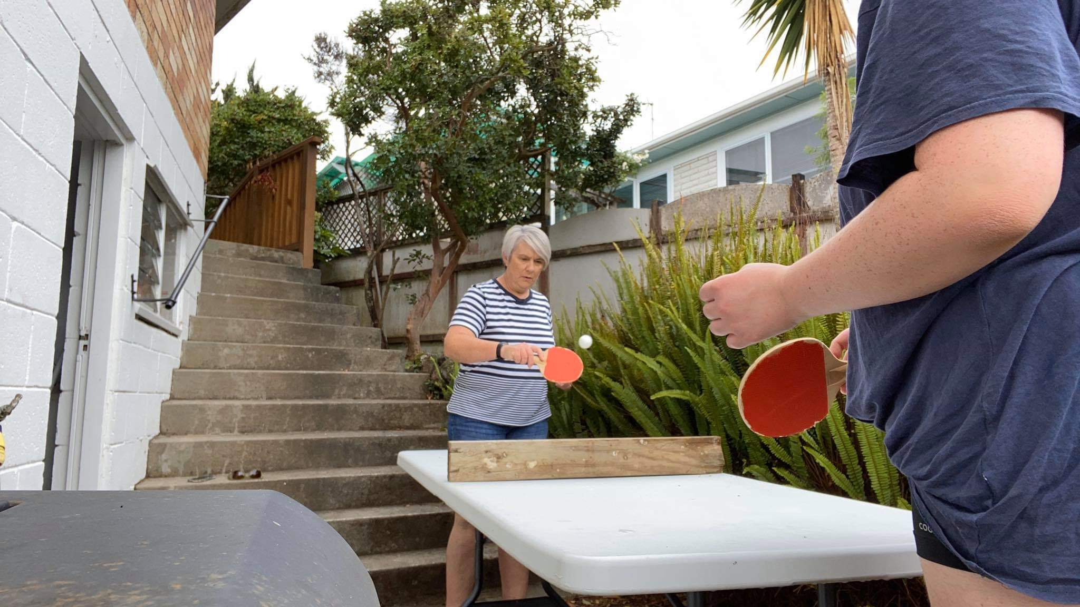
Kei te aha Ā Mrs boyd? Kei te hīangatēpu tēnehi Ā Mrs Boyd. Mrs Boyd is playing table tennis.

Slide 5
Kei te aha Ā Mrs Haynes?
Kei te tuna kai Ā Mrs Haynes
(Mrs Haynes is cooking).

Slide 6
Kei te aha Ā Mrs Russell?
Kei te hikoi Ā Mrs Russell.
Mrs Russell is walking.

Slide 7
Kei te aha Ā Mrs Zhao?
Kei te kimi Ā Mrs Zhao I ngā Teti pea.
(MRs Zhao is looking for teddy bears).

Slide 8
Kei te aha Ā Ms Young?
Kei te piu Ā Ms Young.
(Ms young is skipping)

Slide 9
Kei te aha ā MRs Mokalei?
Kei te kōrero ā MRs Mokalei ki tōna whanāu.
Mrs Mokalei is talking with her family.

Slide 10
Kei te aha Ā Ms Sampson?
Kei te hīkoi Ā Ms Sampson I ō na kuri.
(Ms Sampson is walking the dogs).

Slide 11
Kei te aha Ā Mrs Mafile’o?
Kei te pana-umu Ā Mrs Mafile’o.
Mrs Mafile’o is doing push ups.

Slide 12
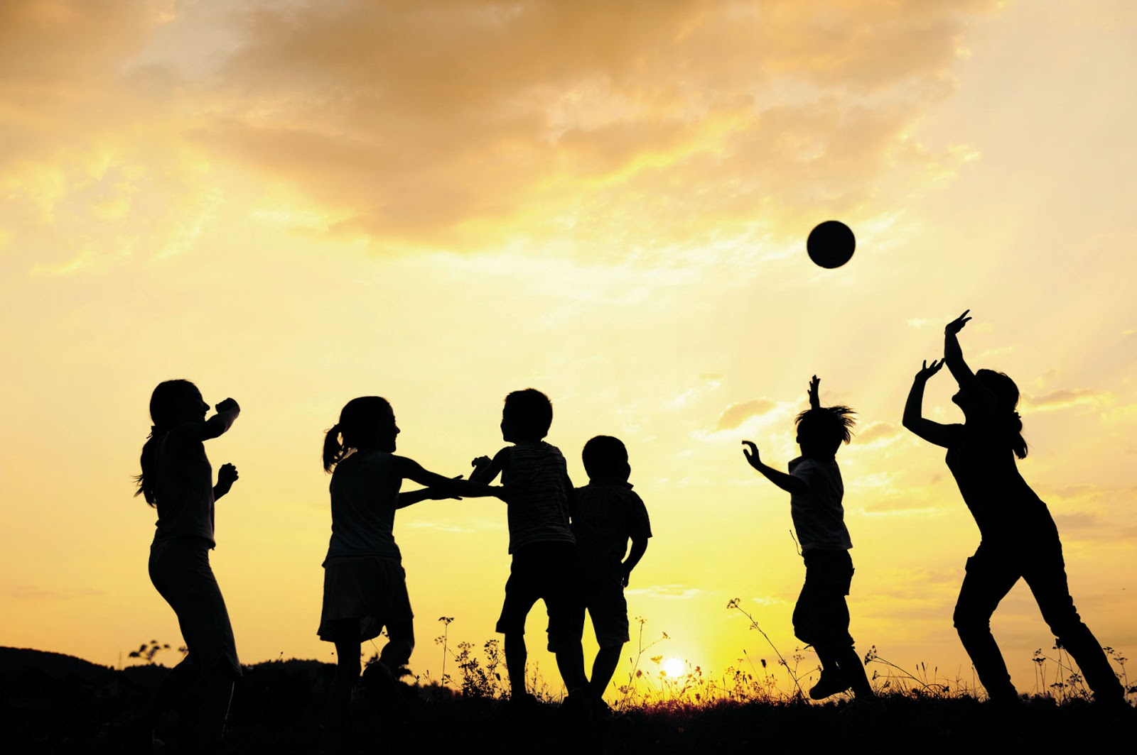
Kei te aha koe? What are you doing?

